Slide 1
Model Validation
Model Validation and
Selection
Dr. Umberto Michelucci
umberto.Michelucci@toelt.ai
© Dr. Umberto Michelucci - umberto.michelucci@toelt.ai

Slide 2
Source
You will find in this presentation definition, figures, etc. with numbering that may seem not to make any sense. The reason is that they are taken from my upcoming book: Fundamental Mathematical Concepts for Machine Learning in Science, Umberto Michelucci, Springer Nature (available in 2024).
© Dr. Umberto Michelucci - umberto.michelucci@toelt.ai

Slide 3
Model Validation
Model Validation
Model validation refers to the process of confirming that the model actually achieves its intended purpose.
Quiz: what is the intended purpose of a machine learning model?
© Dr. Umberto Michelucci - umberto.michelucci@toelt.ai

Slide 4


Model Validation
Model Validation
ü
Hospital 1
x
© Dr. Umberto Michelucci - umberto.michelucci@toelt.ai
Hospital 2
Trained Model
…
x
Hospital N

Slide 5
Model Validation
Model Validation
ü
Hospital 1
ü
© Dr. Umberto Michelucci - umberto.michelucci@toelt.ai
Hospital 2
Trained Model
…
ü
Hospital N

Slide 6
Challenges
Model Validation - Challenges
You have often a very limited dataset at disposal
You do not have the data from Hospital 2, 3, …, N
How can you check that the model is working with the data of all hospitals?
Or in “machine learning” terminology, how can you verify that your model generalise well?
© Dr. Umberto Michelucci - umberto.michelucci@toelt.ai

Slide 7
Model Validation
Model validation refers to the process of confirming that the model actually achieves its intended purpose.
The intended purpose of a model is, in almost all cases, to be able to find patterns in data with an expected level of performance on unseen data (generalisation) statistically similar to the one used for training.
© Dr. Umberto Michelucci - umberto.michelucci@toelt.ai

Slide 8
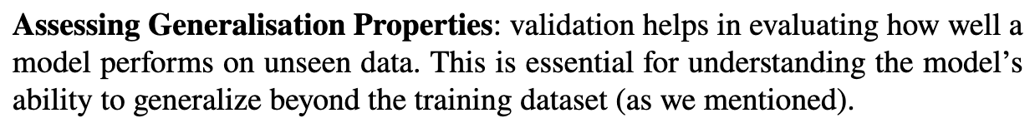
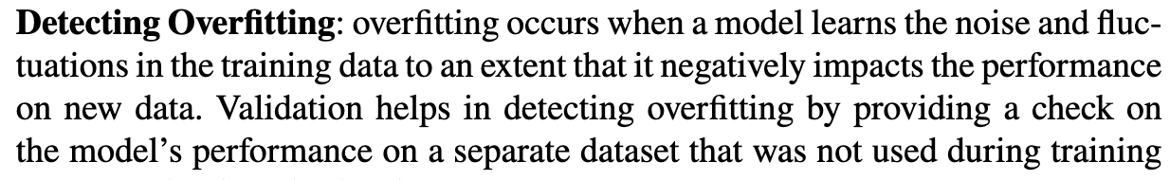
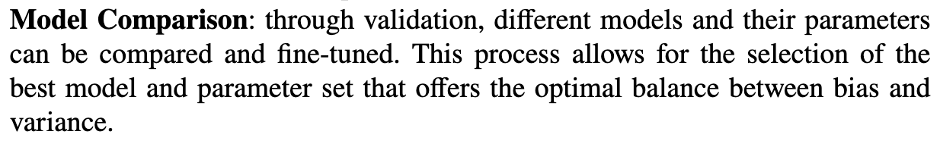
Why “validation” is important
© Dr. Umberto Michelucci - umberto.michelucci@toelt.ai

Slide 9
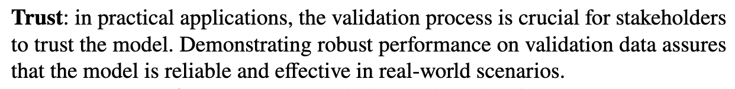
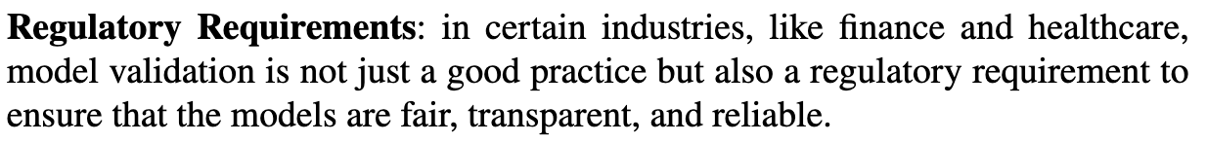
Why “validation” is important
© Dr. Umberto Michelucci - umberto.michelucci@toelt.ai

Slide 10
Why “validation” is important
Ovefitting
Requirements: your model may need to satisfy specfic requirements as
Speed
Energy Consumption
Memory Consumption
This is typical, for example, for applications for space.
© Dr. Umberto Michelucci - umberto.michelucci@toelt.ai

Slide 11
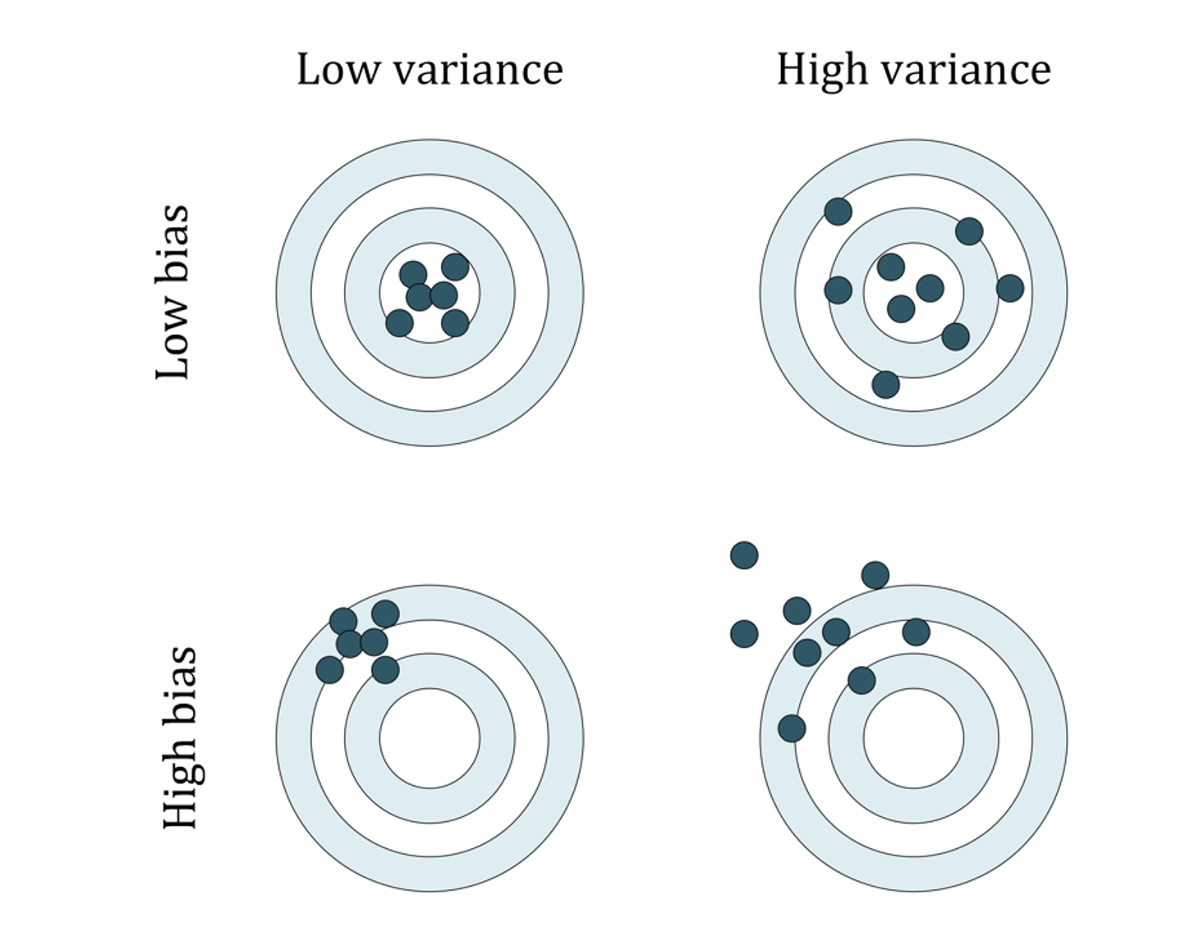
Some terminology: variance and bias
Ovefitting
© Dr. Umberto Michelucci - umberto.michelucci@toelt.ai
U. Michelucci, Applied Deep Learning with TensorFlow 2, Springer Nature, 2022

Slide 12
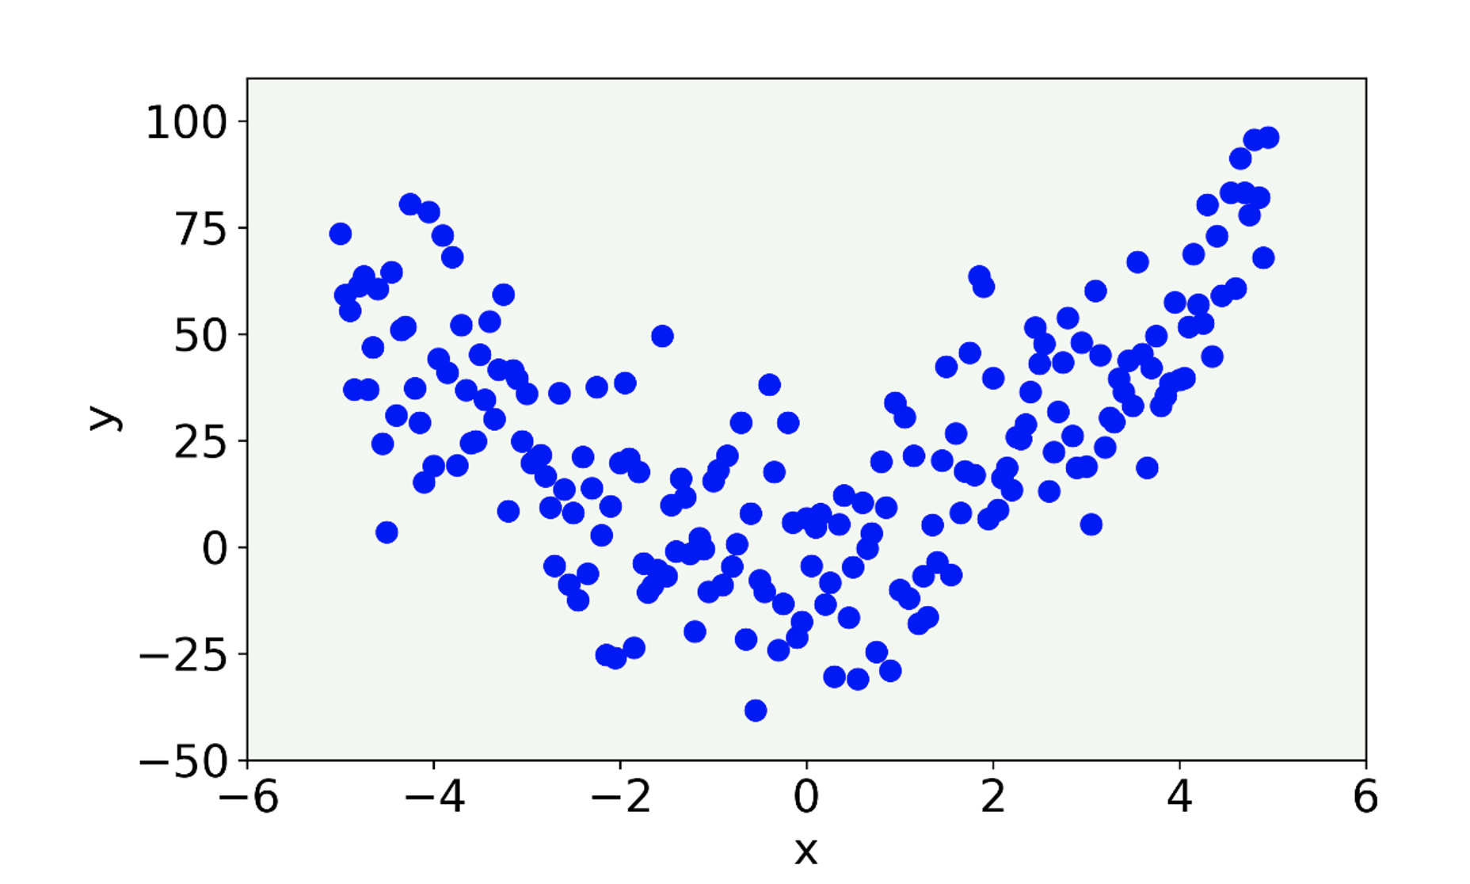
Overfitting I
Ovefitting
Let us consider a set of data generated from a quadratic formula with some noise added.
© Dr. Umberto Michelucci - umberto.michelucci@toelt.ai
U. Michelucci, Applied Deep Learning with TensorFlow 2, Springer Nature, 2022

Slide 13
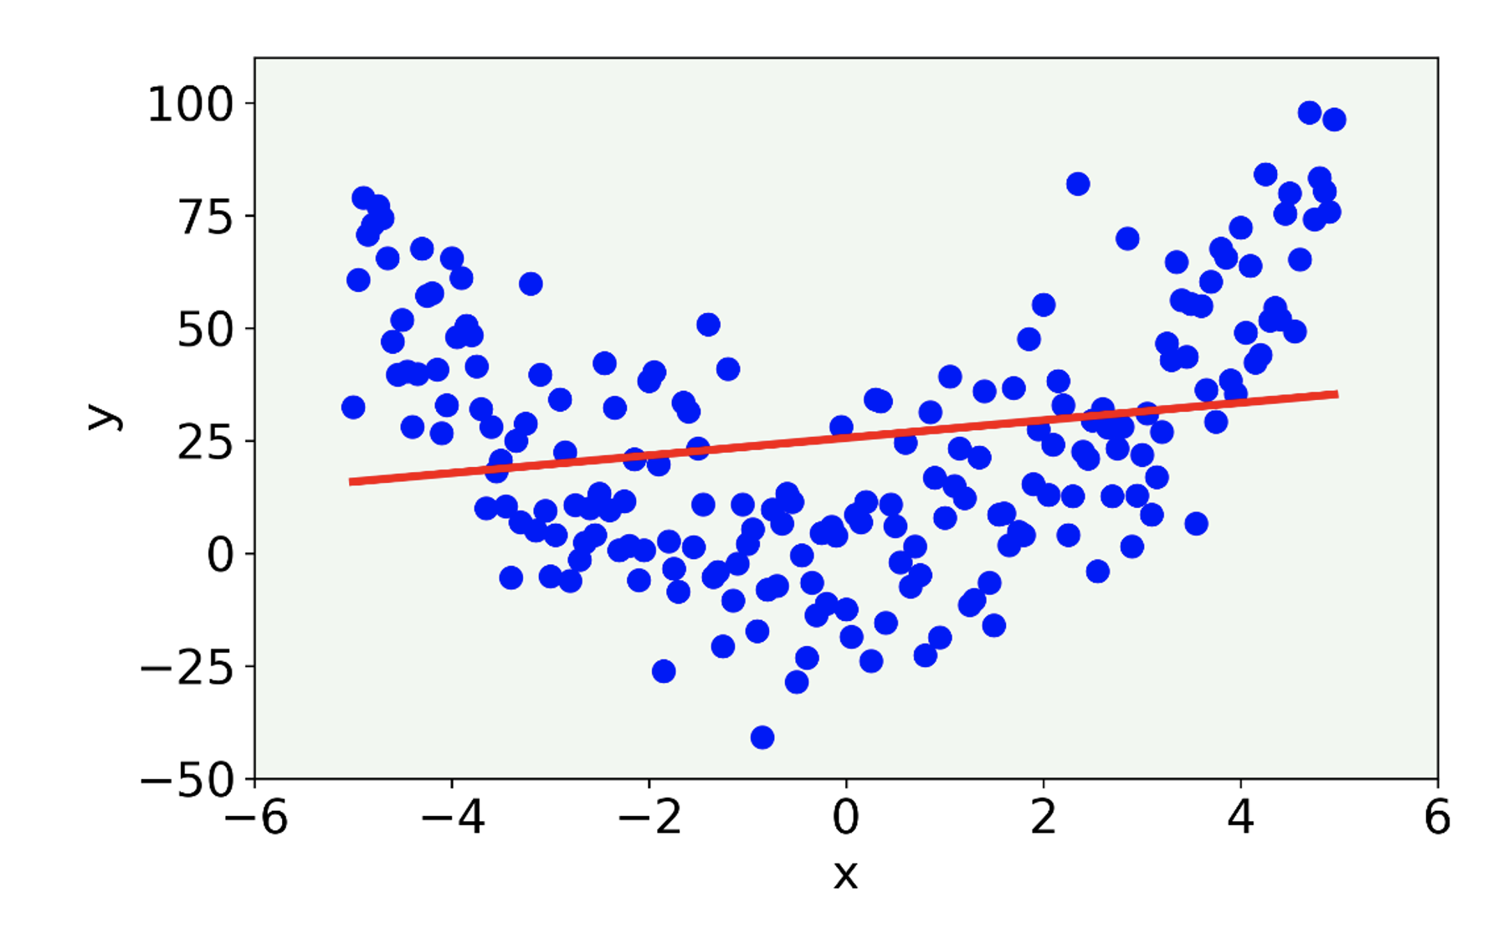
Overfitting II
Ovefitting
The linear model misses the main features of the data being too simple. In this case the model is said to have high bias.
© Dr. Umberto Michelucci - umberto.michelucci@toelt.ai
U. Michelucci, Applied Deep Learning with TensorFlow 2, Springer Nature, 2022

Slide 14
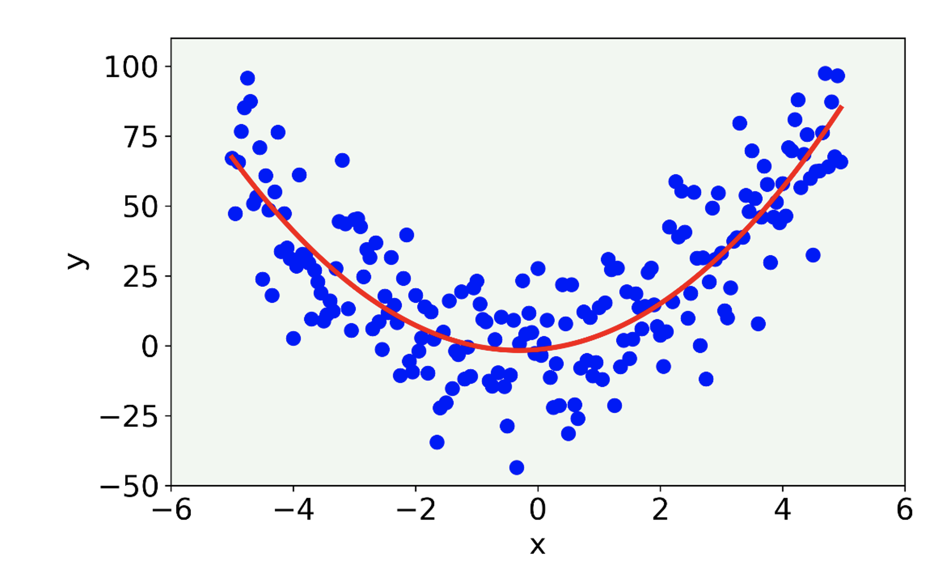
Overfitting III
Ovefitting
The result (red line) for a 2-degree polynomial.
© Dr. Umberto Michelucci - umberto.michelucci@toelt.ai
U. Michelucci, Applied Deep Learning with TensorFlow 2, Springer Nature, 2022

Slide 15
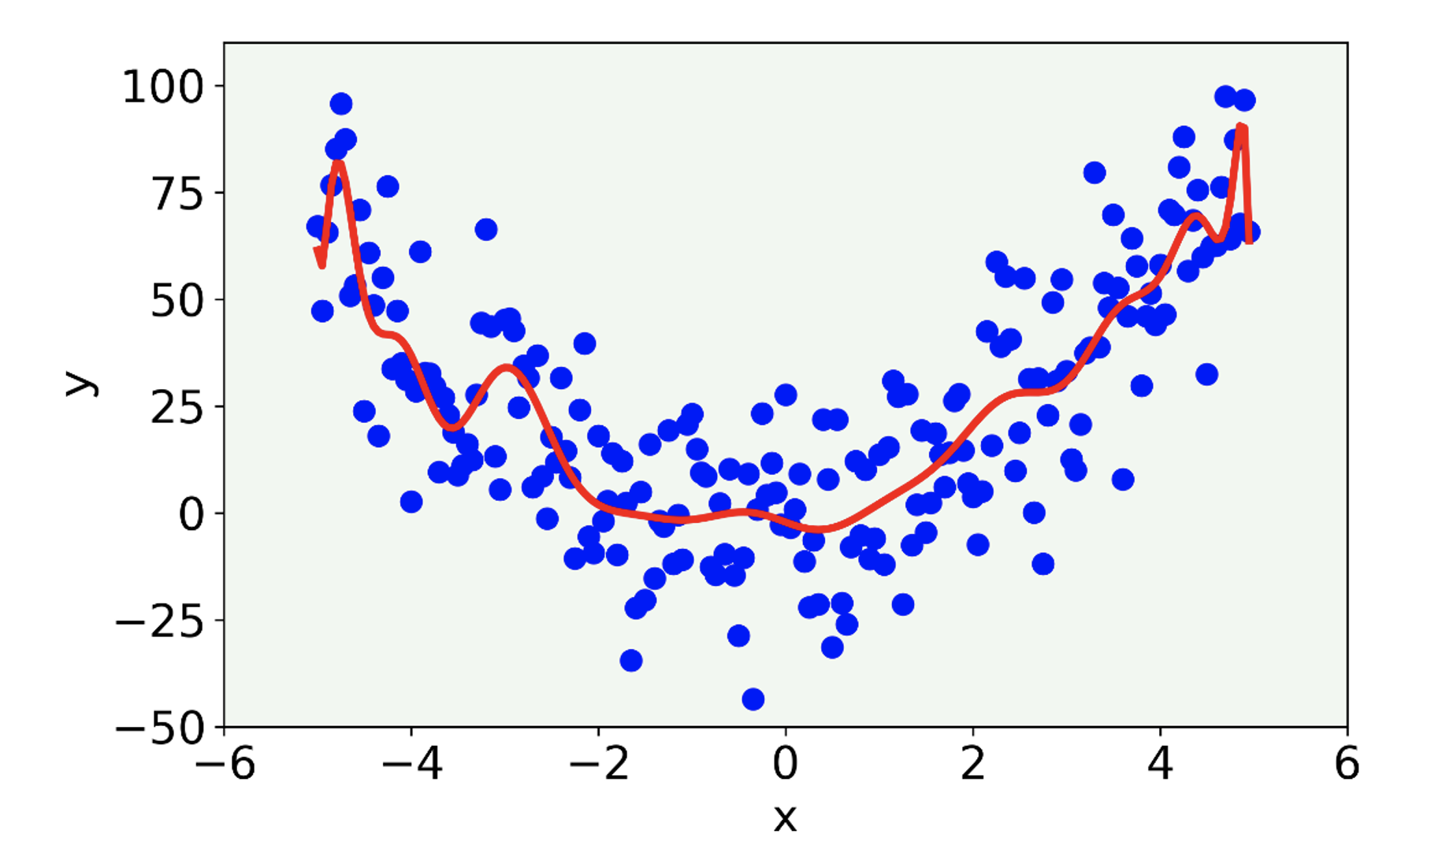
Overfitting IV
Ovefitting
The result for a 21-degree polynomial model.
Here we talk about overfitting, since the model capture the noise present in the data. The model is too complex.
© Dr. Umberto Michelucci - umberto.michelucci@toelt.ai
U. Michelucci, Applied Deep Learning with TensorFlow 2, Springer Nature, 2022

Slide 16
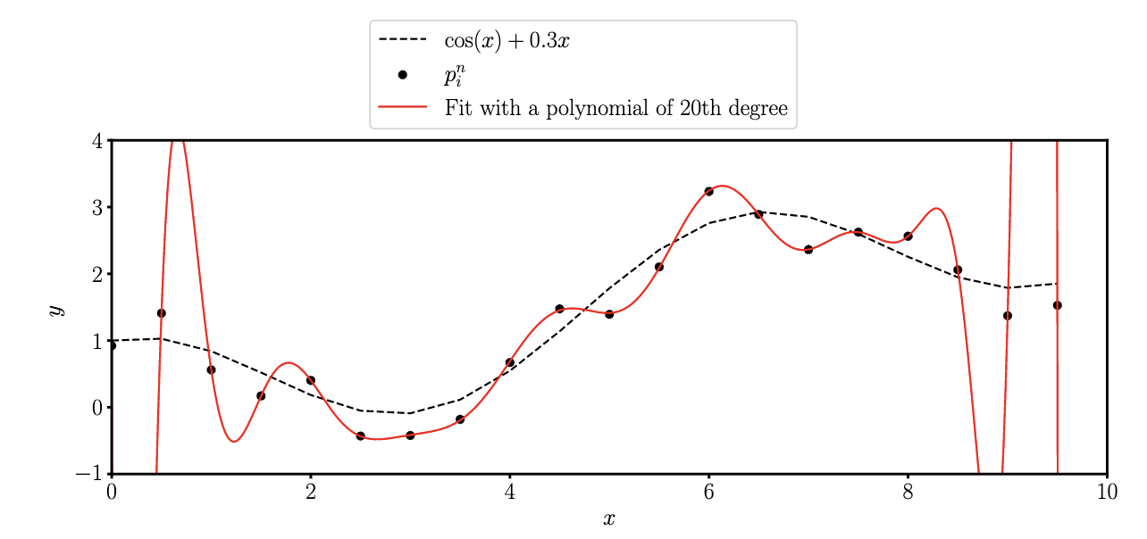
Another Example – model too complex
Generating function
Values with noise added
© Dr. Umberto Michelucci - umberto.michelucci@toelt.ai

Slide 17
Overfitting
Ovefitting
A model may, due to its flexibility, learn patterns that are due to noise, errors or simply wrong data.
How can we detect it? How can we visualise its occurrence?
When overfitting occurs, the model evaluated on unseen data will have a bad performance.
© Dr. Umberto Michelucci - umberto.michelucci@toelt.ai

Slide 18
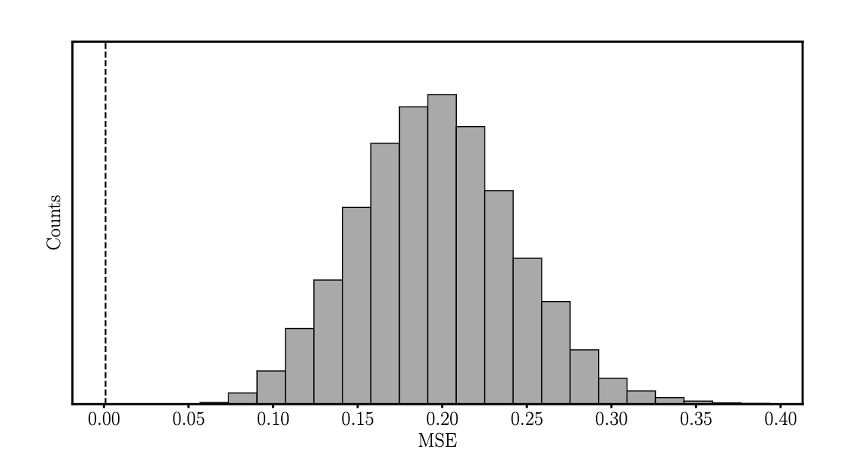
Another Example – model too complex
Ovefitting
Distribution of the MSE obtained by fitting a 20^{𝑡ℎ} polynomial to one dataset, and then evaluating the MSE between the polynomial and 10000 datasets obtained by generating each time new random noise. The dashed vertical line is the MSE evaluated on the training dataset.
© Dr. Umberto Michelucci - umberto.michelucci@toelt.ai

Slide 19
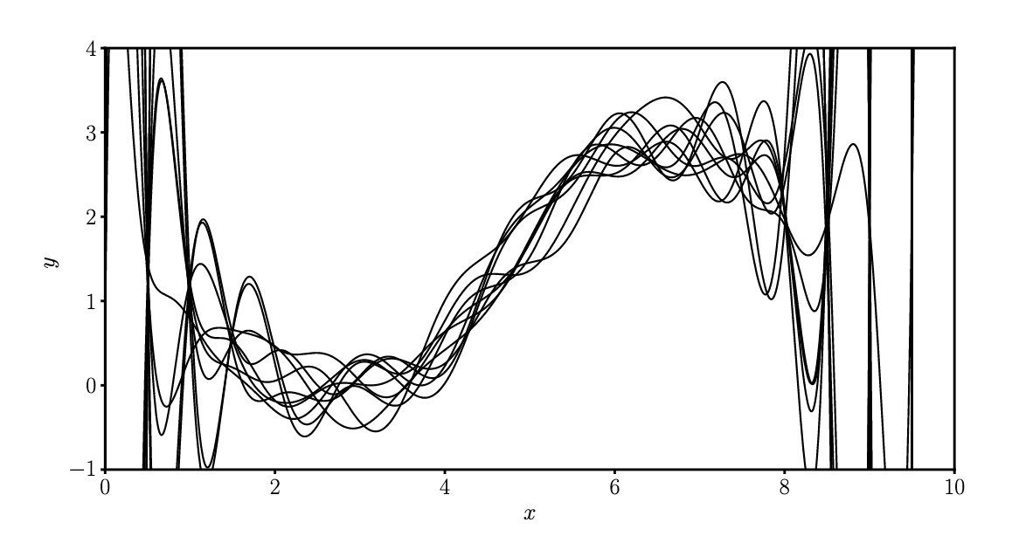
Another Example – model too complex
Ovefitting
The result of fitting a 20^{𝑡ℎ} polynomial to multiple dataset of points obtained by generating each time different random noise.
This regine is called: HIGH VARIANCE
© Dr. Umberto Michelucci - umberto.michelucci@toelt.ai

Slide 20
Overfitting VI
Ovefitting
In 99.9999% of cases a visualisation is not possible, so how can we detect it?
→ To detect it we need to test our model on unseen data. To achieve this, we need to split our dataset in two portions.
© Dr. Umberto Michelucci - umberto.michelucci@toelt.ai

Slide 21
Definition of Cross-Validation
© Dr. Umberto Michelucci - umberto.michelucci@toelt.ai

Slide 22
Cross-Validation (CV)
Cross-Validation
Cross-validation is a statistical method used to estimate the skill of machine learning models. It is primarily used to assess how the results of a predictive model will generalize to an independent data set.
The basic idea is to divide the total data into multiple subsets or "folds." The model is then trained on a subset of the folds (training set) and tested on the remaining fold (validation set). This process is repeated multiple times, with each fold being used once as the validation set.
© Dr. Umberto Michelucci - umberto.michelucci@toelt.ai

Slide 23
Model Validation - Methods
Model Validation - Methods
Hold-out Approach
Monte-Carlo Cross Validation
K-Fold Cross Validation
Leave-one-out Cross Validation
y-Randomisation
© Dr. Umberto Michelucci - umberto.michelucci@toelt.ai

Slide 24
Hold-out Approach
Hold-out Approach
© Dr. Umberto Michelucci - umberto.michelucci@toelt.ai

Slide 25
Hold-out Approach
Hold-out Approach
Also called Hold-out set
Dataset
Training Set
Test Set
© Dr. Umberto Michelucci - umberto.michelucci@toelt.ai
Train the model
Evaluate the model
Evaluate the metric
Evaluate the metric
Compare the two metric values

Slide 26
Hold-out Approach
Hold-out Approach
If the train and test value of (for example) the error is similar → the model generalise well (kind of, at least it behaves similary on the two sets)
If the train and test value of (for example) the error is different → the model generalise badly (kind of, it behaves differently on the two sets)
© Dr. Umberto Michelucci - umberto.michelucci@toelt.ai

Slide 27
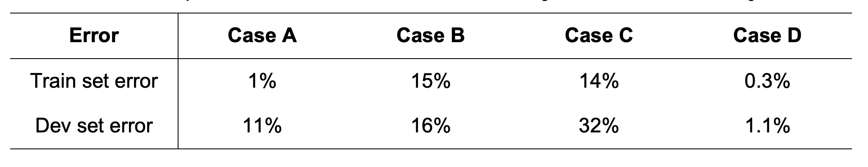
Hold-out Approach
© Dr. Umberto Michelucci - umberto.michelucci@toelt.ai
Case A: here we are overfitting (high variance), because we are doing very well on the training set, but our model generalizes very badly to our dev set
Case B: here we see a problem with high bias, meaning that our model is not doing very well generally, on both datasets
Case C: here we have a high bias (the model cannot predict very well the training set) and high variance (the model does not generalize well on the dev set).
Case D: here everything seems ok. Good error on the train set and good on the dev set. That is a good candidate for our best model.
U. Michelucci, Applied Deep Learning with TensorFlow 2, Springer Nature, 2022

Slide 28
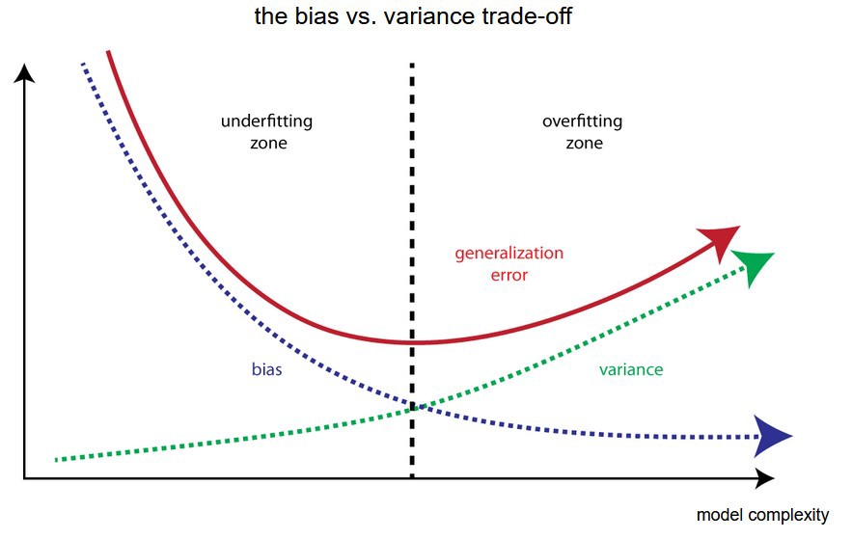
Bias-Variance Trade-off
Bias-Variance Trade-off
Error
Error evaluated on the
“test” dataset
© Dr. Umberto Michelucci - umberto.michelucci@toelt.ai
Error evaluated on the
“train” dataset
Image © Towarddatascience.com

Slide 29
Essence of overfitting
Essence of overfitting
Note The essence of overfitting is to have unknowingly extracted some of the residual variation (i.e. the noise) as if that variation represented underlying model structure. The opposite is called underfitting when the model cannot capture the structure of the data
© Dr. Umberto Michelucci - umberto.michelucci@toelt.ai

Slide 30
Stratified Sampling
Stratified Sampling
When using the hold-out approach you should look out for situation where by splitting the dataset you end up with a 𝐷_{𝑇} that is at all not representative of the original dataset (or the original research question).
© Dr. Umberto Michelucci - umberto.michelucci@toelt.ai

Slide 31
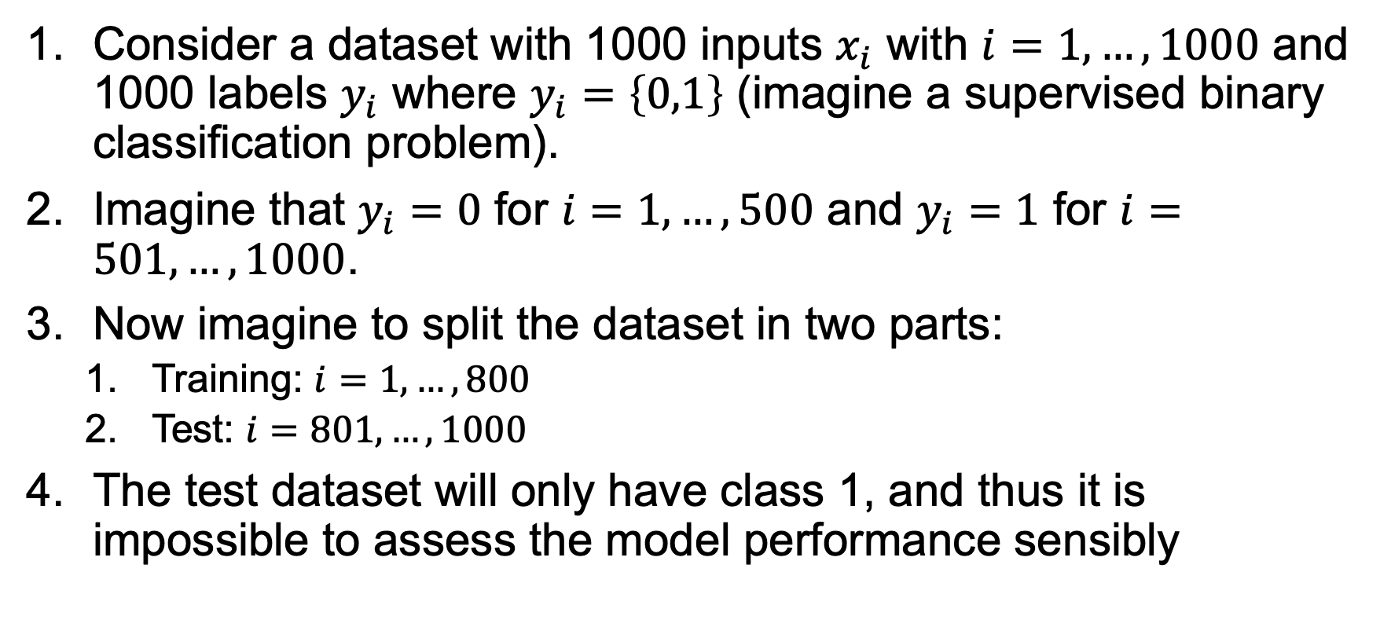
Hold-out approach – a possible problem
Stratified Sampling
Consider a dataset with 1000 inputs $x_{i}$ with $i=1,…,1000$ and 1000 labels $y_{i}$ where $y_{i}=\left\{0,1\right\}$ (imagine a supervised binary classification problem).
Imagine that $y_{i}=0$ for $i=1,…,500$ and $y_{i}=1$ for $i=501, …, 1000$.
Now imagine to split the dataset in two parts:
Training: $i=1,…,800$
Test: $i=801,…,1000$
The test dataset will only have class 1, and thus it is impossible to assess the model performance sensibly
© Dr. Umberto Michelucci - umberto.michelucci@toelt.ai

Slide 32
Hold-out approach – a solution (stratified sampling)
Stratified Sampling
The solution to the previous problem is the so-called «stratified sampling».
In general stratified sampling is a method of sampling from a population (in our example, the original dataset 𝐷) which is partitioned into sub-populations (in a classification problem the sub-populations can be the classes)
You split the dataset in such a way that each portion has the same proportions of the classes (for example by shuffling the data before splitting)
© Dr. Umberto Michelucci - umberto.michelucci@toelt.ai

Slide 33
Splitting done right
Stratified Sampling
In general you should split the dataset in such a way that each portion is representative of the entire dataset (or the research question you are trying to solve).
© Dr. Umberto Michelucci - umberto.michelucci@toelt.ai

Slide 34
Data Leakage
© Dr. Umberto Michelucci - umberto.michelucci@toelt.ai

Slide 35
What is data leakage
Data Leakage
Data leakage in machine learning and data science refers to a situation in which information from outside the training dataset (for example from the test dataset) is inadvertently used to create or train the model.
This leakage of information typically results in a model that performs unrealistically well on the training data, but poorly on unseen, real-world data.
© Dr. Umberto Michelucci - umberto.michelucci@toelt.ai

Slide 36
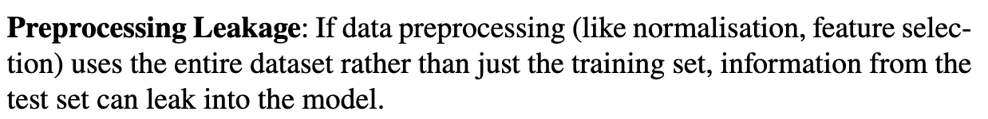
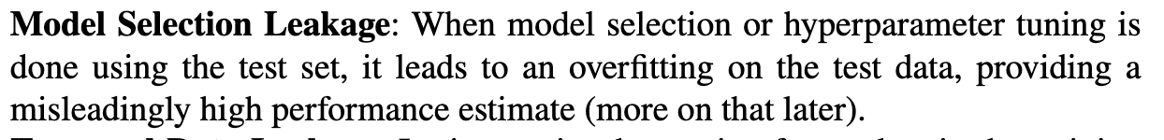
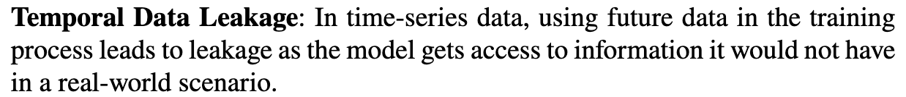
Types of data leakage
Data Leakage
© Dr. Umberto Michelucci - umberto.michelucci@toelt.ai

Slide 37
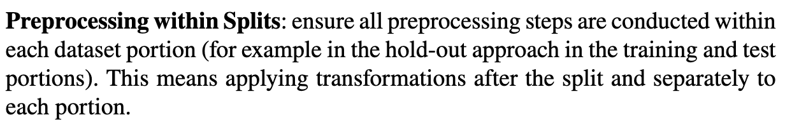
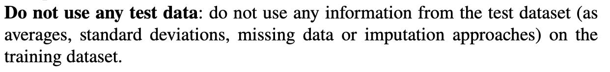
How to deal with data leakage
Data Leakage
© Dr. Umberto Michelucci - umberto.michelucci@toelt.ai

Slide 38
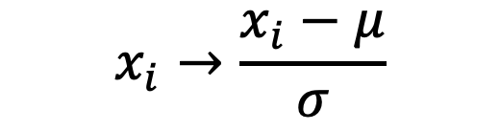
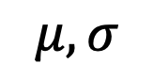
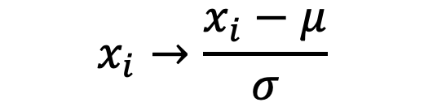
Data Leakage Example of Zero Average-Standard Deviation of one
Data Leakage
Normalise the data to have an average of zero and a standard deviation of one.
These contains information on the test dataset.
© Dr. Umberto Michelucci - umberto.michelucci@toelt.ai
Training
Dataset
$$x_{i}→\frac{x_{i}−μ}{σ}$$
Data
$$μ, σ$$
Average and
standard devitation
Test
Dataset
$$x_{i}→\frac{x_{i}−μ}{σ}$$
Data Leakage

Slide 39
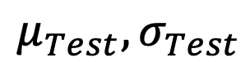
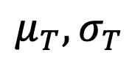
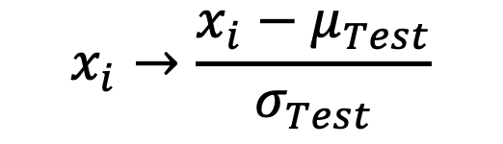
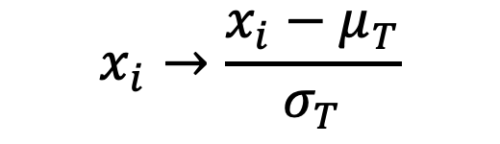
Preprocessing within splits Example of Zero Average-Standard Deviation of one
Data Leakage
Normalise the data to have an average of zero and a standard deviation of one.
© Dr. Umberto Michelucci - umberto.michelucci@toelt.ai
Training
Dataset
$$μ_{T}, σ_{T}$$
$$x_{i}→\frac{x_{i}−μ_{T}}{σ_{T}}$$
Data
Average and
standard devitation
Test
Dataset
$$x_{i}→\frac{x_{i}−μ_{Test}}{σ_{Test}}$$
$$μ_{Test}, σ_{Test}$$
HUGE ASSUMPTION: the split has been done so that the two datasets are ”statistically similar”.

Slide 40
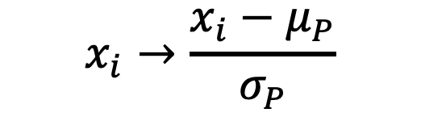
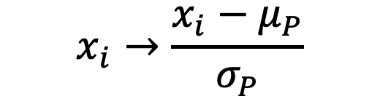
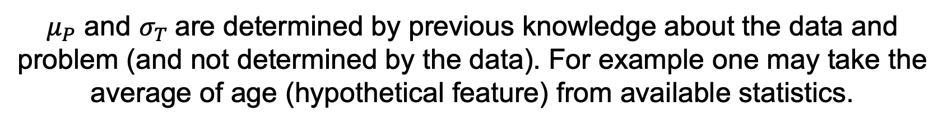
Data-agnostic Preprocessing Example of Zero Average-Standard Deviation of one
Data Leakage
Normalise the data to have an average of zero and a standard deviation of one.
© Dr. Umberto Michelucci - umberto.michelucci@toelt.ai
Training
Dataset
$$x_{i}→\frac{x_{i}−μ_{P}}{σ_{P}}$$
Data
$$x_{i}→\frac{x_{i}−μ_{P}}{σ_{P}}$$
Test
Dataset
$μ_{P}$ and $σ_{T}$are determined by previous knowledge about the data and problem (and not determined by the data). For example one may take the average of age (hypothetical feature) from available statistics.

Slide 41
Monte-Carlo Cross Validation
Monte-Carlo Cross Validation
© Dr. Umberto Michelucci - umberto.michelucci@toelt.ai

Slide 42
Hold-out Approach with multiple splits (Monte Carlo Cross-Validation)
Monte-Carlo Cross Validation
Dataset
© Dr. Umberto Michelucci - umberto.michelucci@toelt.ai
Training Set
Test Set
N times
N times
Train the model
Evaluate the model
Evaluate the metric
Evaluate the metric

Slide 43
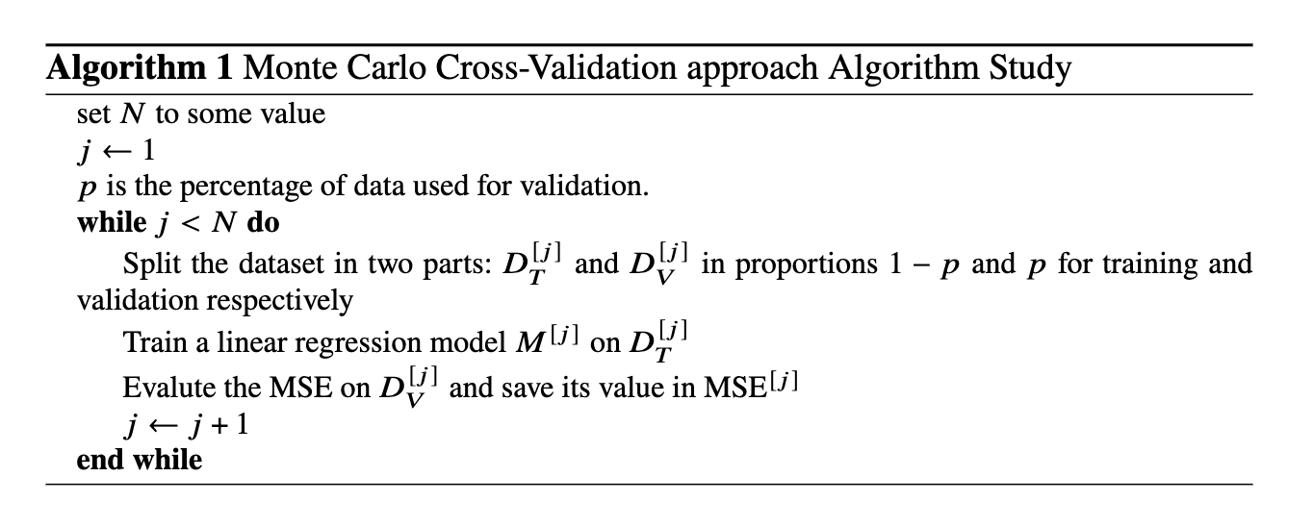
Monte-Carlo CV
Monte-Carlo Cross Validation
© Dr. Umberto Michelucci - umberto.michelucci@toelt.ai

Slide 44
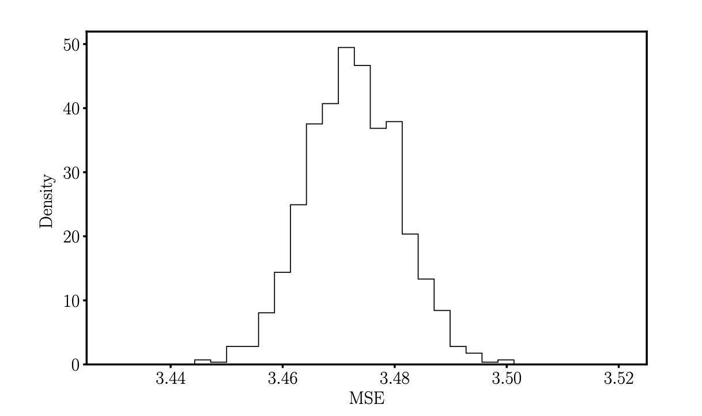
Monte-Carlo CV
Monte-Carlo Cross Validation
The MSE distribution obtained with previous algorithm with 𝑁 = 5 · 10⁴
and 𝑝 = 0.3
© Dr. Umberto Michelucci - umberto.michelucci@toelt.ai
Yes: the distribution is very similar to a Gaussian (normal) one (due to the Central Limit Theorem)

Slide 45
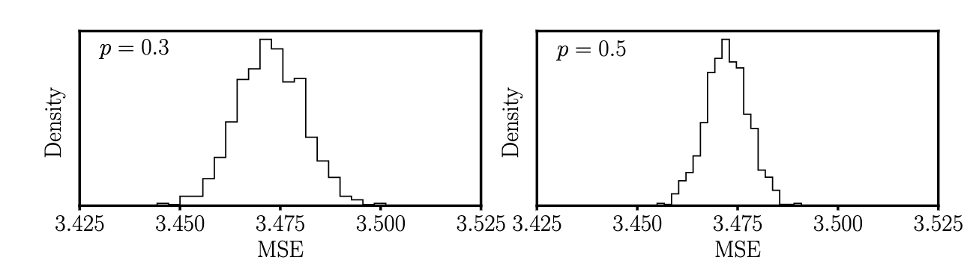
Monte-Carlo CV
Monte-Carlo Cross Validation
© Dr. Umberto Michelucci - umberto.michelucci@toelt.ai
The MSE distribution obtained with Algorithm 1 with 𝑁 = 5 · 10⁴ and 𝑝 = 0.3 (left panel) and 𝑝 = 0.5 (right panel)
The standard deviation depends on the size of the test dataset (central limit theorem). So be very careful!

Slide 46
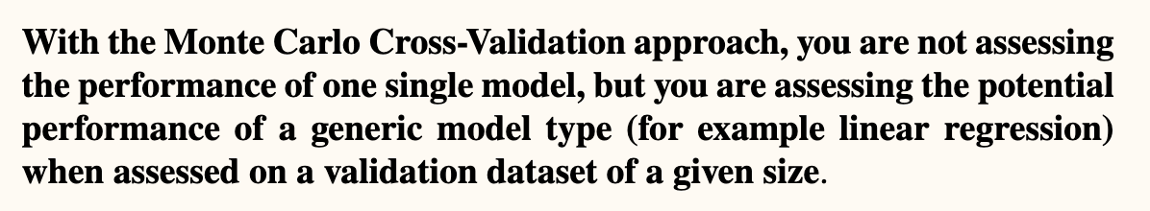
Monte-Carlo CV
Monte-Carlo Cross Validation
© Dr. Umberto Michelucci - umberto.michelucci@toelt.ai

Slide 47
K-Fold Approach
k-Fold Cross Validation
You get K values of the chosen metric.
→ You can evaluate mean and variance of the metric for the training and for the test set.
© Dr. Umberto Michelucci - umberto.michelucci@toelt.ai

Slide 48
Some tips and remarks
k-Fold Cross Validation
K-Fold is typically used when the dataset is small. Typically one chooses K=5-10 (the higher the more computational requirements you have)
Leave-one-out (K-Fold with K=1) is used for very small datasets
Hold-out with multiple split is often used
Comparison of models (and thus of mean and variance) requires statistical tests (like the t-test) (that we cannot cover in this lecture)
© Dr. Umberto Michelucci - umberto.michelucci@toelt.ai

Slide 49
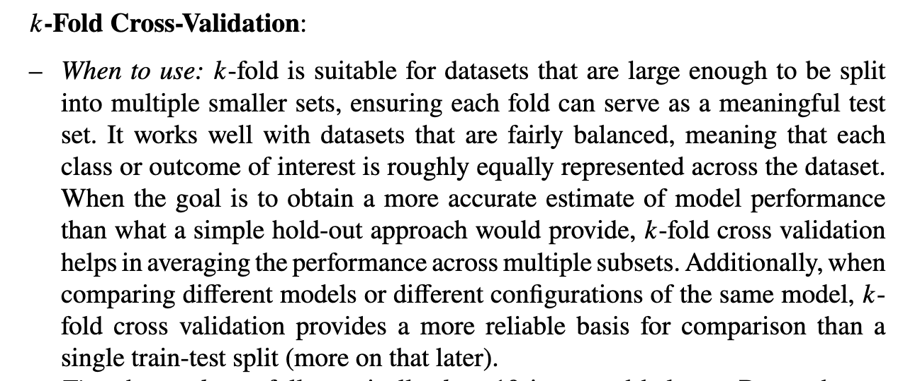
Which CV method to choose
Which CV method to choose
© Dr. Umberto Michelucci - umberto.michelucci@toelt.ai

Slide 50
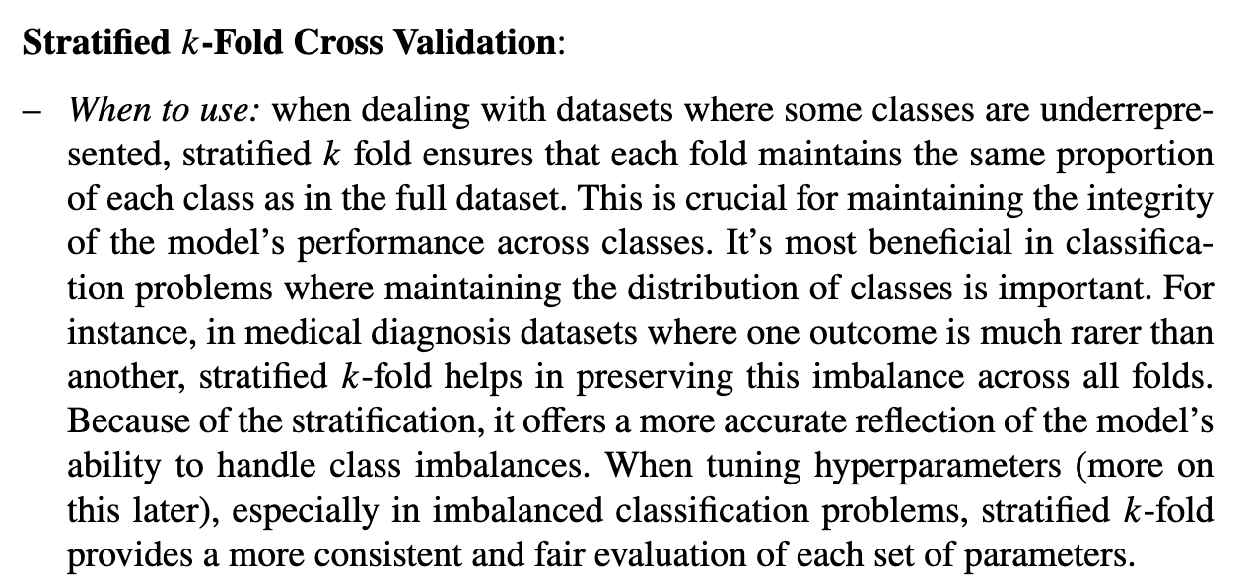
Which CV method to choose
Which CV method to choose
© Dr. Umberto Michelucci - umberto.michelucci@toelt.ai

Slide 51
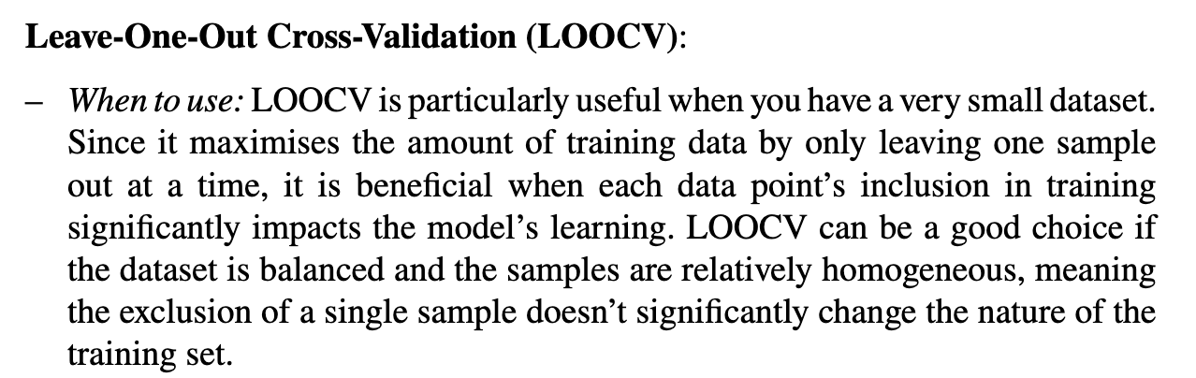
Which CV method to choose
Which CV method to choose
© Dr. Umberto Michelucci - umberto.michelucci@toelt.ai

Slide 52
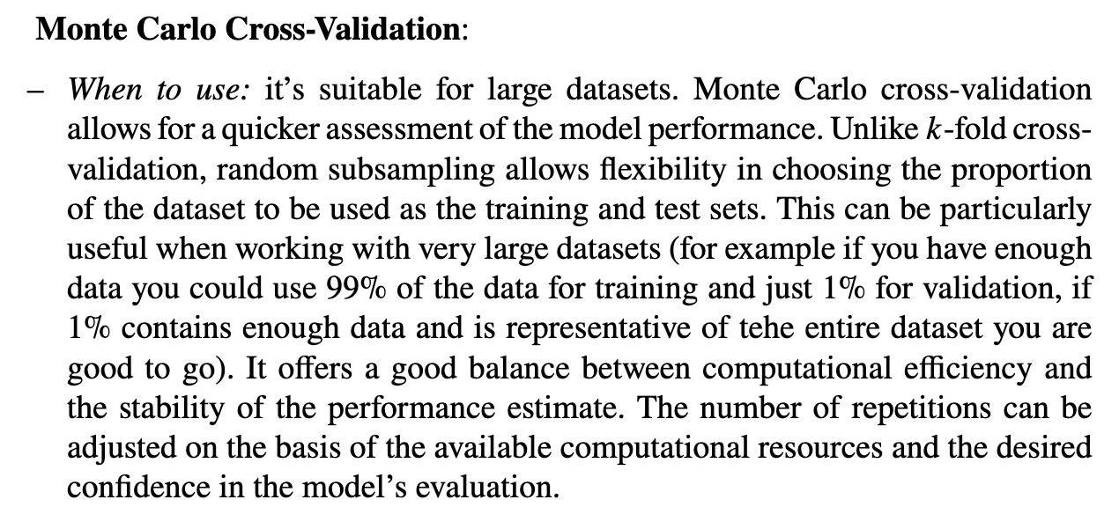
Which CV method to choose
Which CV method to choose
© Dr. Umberto Michelucci - umberto.michelucci@toelt.ai

Slide 53
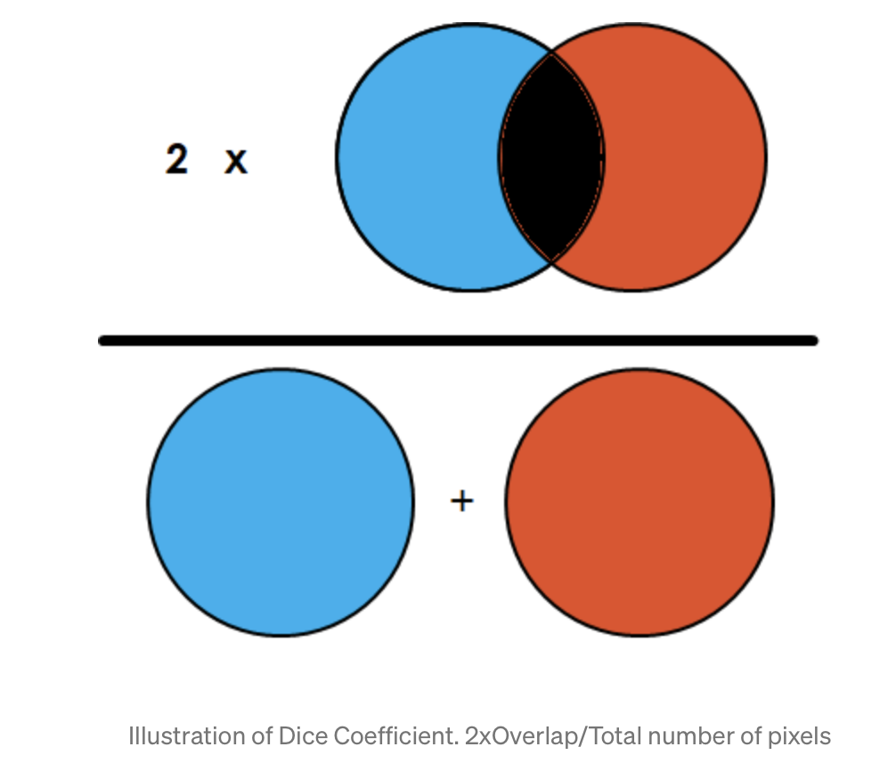
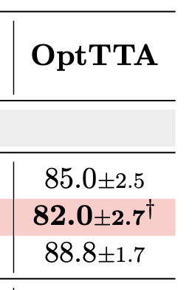
An example
© Dr. Umberto Michelucci - umberto.michelucci@toelt.ai
Image Source: towarddatascience.com
Dice (%) Results (+/- std dev.)
From: Tomar, Devavrat, et al. "OptTTA: Learnable Test-Time Augmentation for Source-Free Medical Image Segmentation Under Domain Shift." Medical Imaging with Deep Learning. 2021.

Slide 54
Model Selection
Model Selection
© Dr. Umberto Michelucci - umberto.michelucci@toelt.ai

Slide 55
Model Selection (Definition)
Model selection in the context of machine learning and statistics is the process of choosing the most appropriate model from a set of candidate models for a given dataset.
The goal of model selection is (typically) to identify the model that best balances the trade-off between underfitting and overfitting, thereby providing the most accurate and generalizable predictions on new, unseen data.
© Dr. Umberto Michelucci - umberto.michelucci@toelt.ai

Slide 56
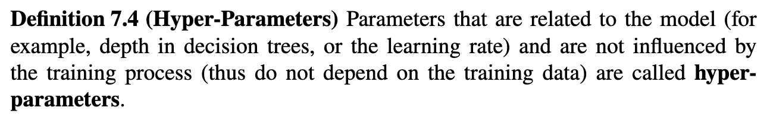
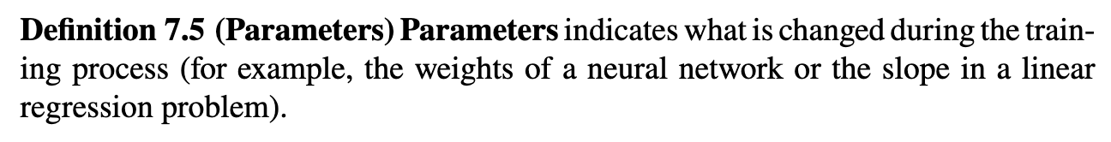
(hyper)-Parameters
(hyper)-parameters
© Dr. Umberto Michelucci - umberto.michelucci@toelt.ai

Slide 57
Model Selection Algorithm
Split the dataset 𝐷 in three parts: 𝐷_{𝑇} for training, 𝐷_{𝑉} for validation and 𝐷_{test} for testing.
Train all 𝑞 models M_{𝑖} on 𝐷_{𝑇}. We will assume that we want to track one single metric 𝑚_{𝑖}(·) (for example MSE or accuracy).
Compute the metric on the validation dataset 𝑚_{𝑖}(𝐷_{𝑉}).
Select the model 𝑗 that has the lowest value for the metric 𝑚_{𝑖} (𝐷_{𝑉}).
Compute the metric on the test dataset 𝑚_{𝑖}(𝐷_{test}).
Compare 𝑚_{𝑖}(𝐷_{test}) with 𝑚_{𝑖}(𝐷_{𝑉}). If the two values are similar you are good and you can finally train your chosen models on the entire dataset, ready to be used on real data.
© Dr. Umberto Michelucci - umberto.michelucci@toelt.ai

Slide 58
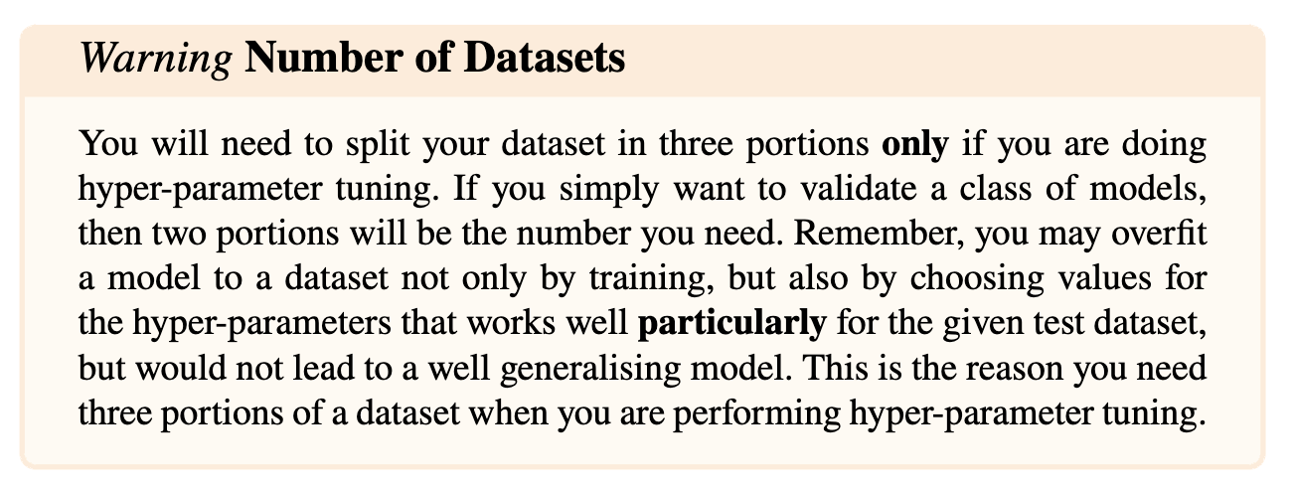
Number of datasets
© Dr. Umberto Michelucci - umberto.michelucci@toelt.ai

